Slide 1
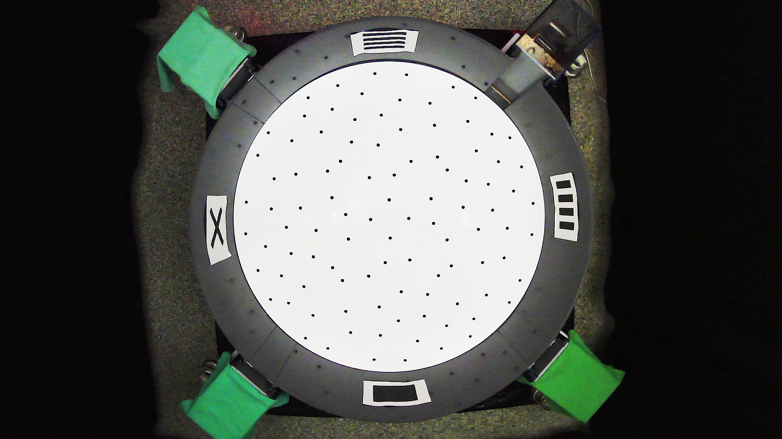
16Jul_21

Slide 2
15Nov_21

Slide 3
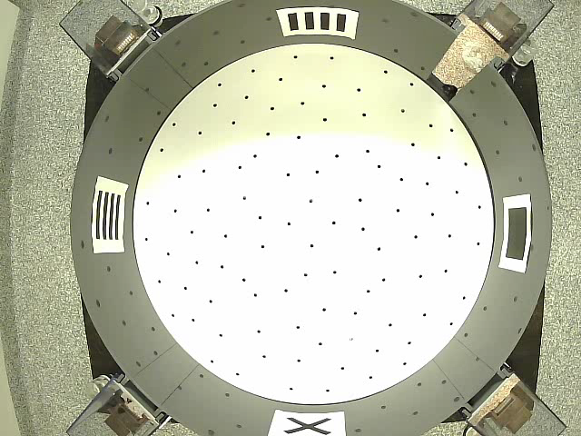
06-Sep & 07-Oct

Slide 4
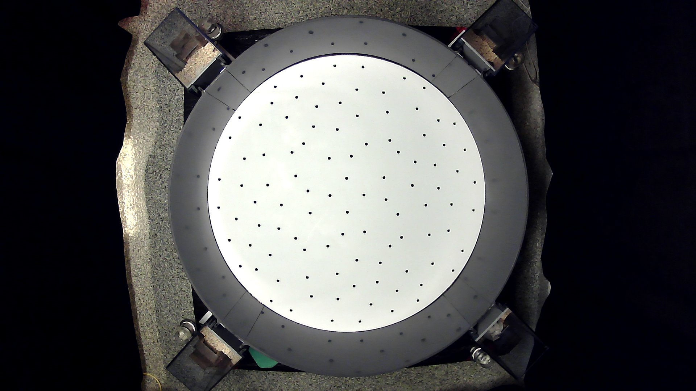
22Jun_21 & 19Nov_21
Rotate according to entrance

